Slide 1
521157A – Introduction to Social Network Seminar
Crime Network Analysis
Giuseppe Superbo
Nicola Zotto
Xiaowen Wang

Slide 2
Background

Slide 3
Dataset
(Oversize Network: https://figshare.com/articles/Oversize_network/3156067)
The zip file contains three networks (adjacency matrices -- binary unweighted -- in CSV format) describing the criminal organization targeted by operation Oversize (2000-2009), an Italian criminal case against a mafia group.
netWR.csv: Wiretap Records
netAW.csv: Arrest Warrant
netJU.csv: Judgement
Tools
Python 3.7
Networkx 2.0

Slide 4

An edge between two nodes is established whenever there is at least one telephone call between the two individuals.

Slide 5
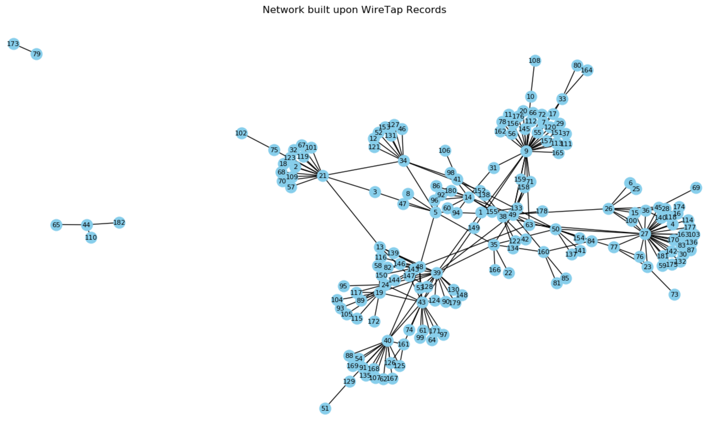
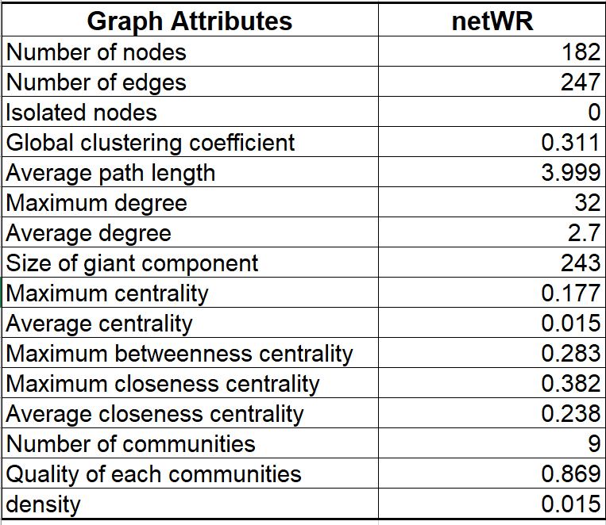
netWR - Original

Slide 6

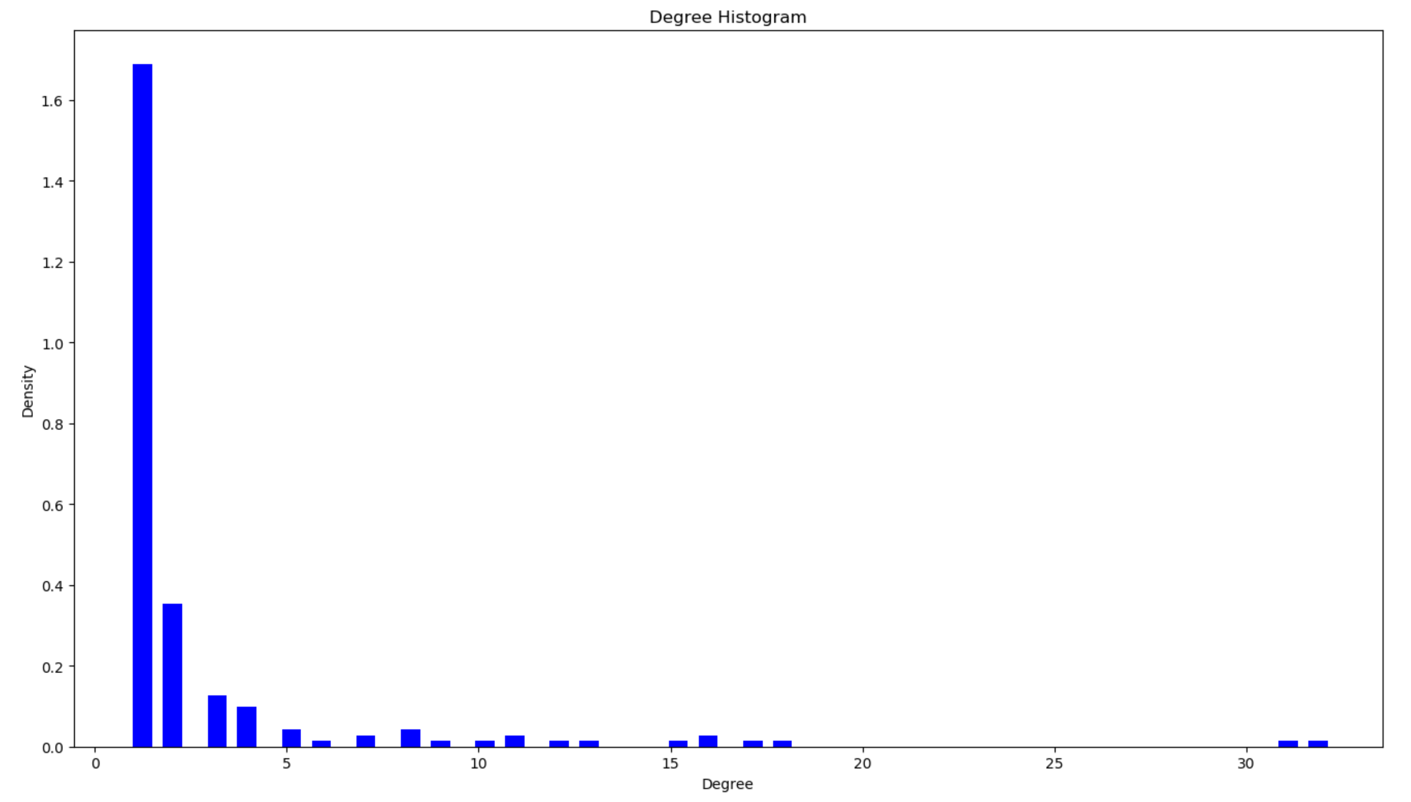
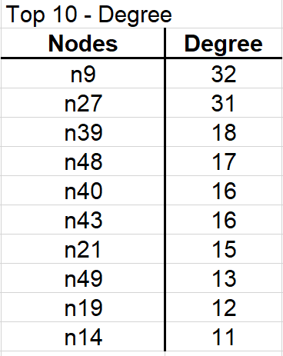
Importance of network members
Indicator 1 - Degree
Mean = 32
Max = 2.71
stDev = 4.42

Slide 7

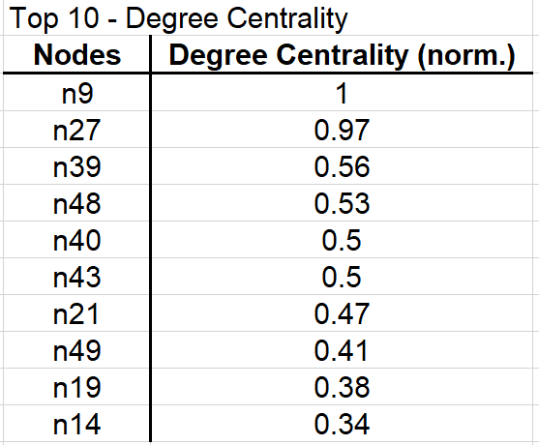
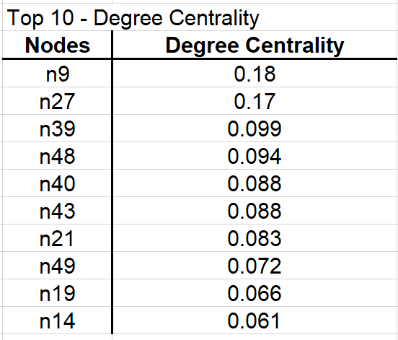
Count how many neighbours a node has.
Indicator 2 – Degree Centrality
Mean = 0.015
Max = 0.18
stDev = 0.024

Slide 8
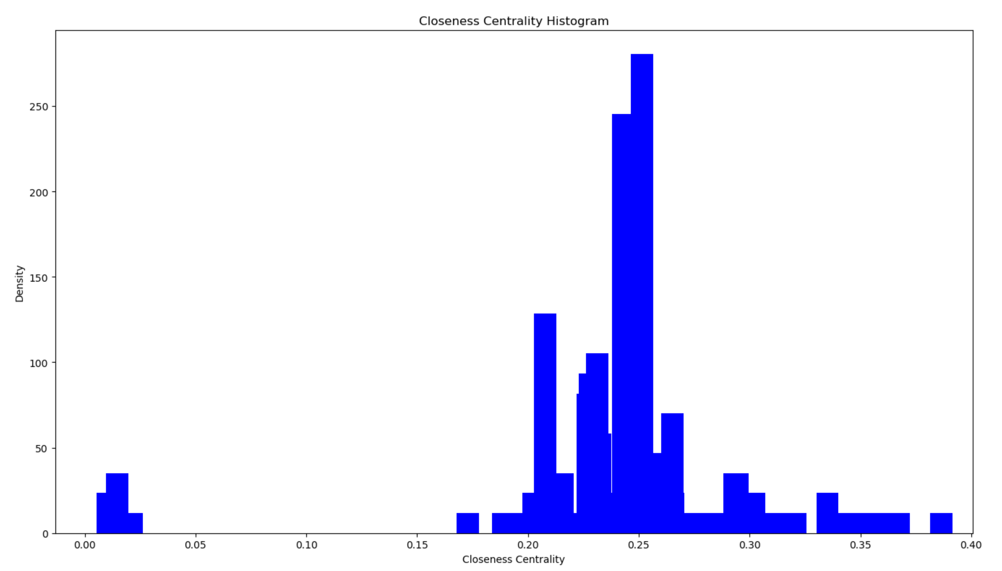
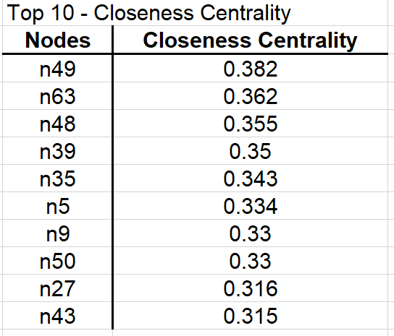
Indicator 3 – Closeness Centrality
How isloated members are?
Mean = 0.24
Max = 0.38
stDev = 0.054

Slide 9
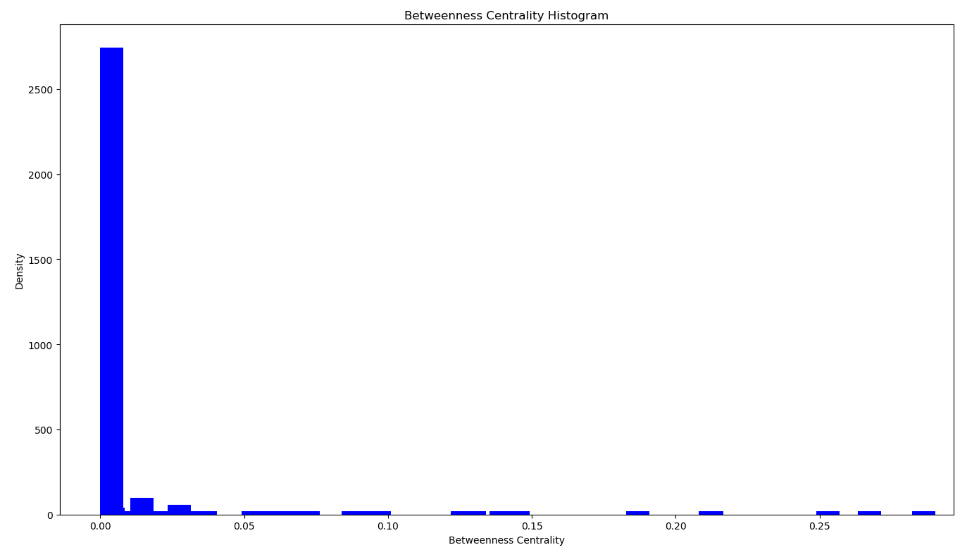
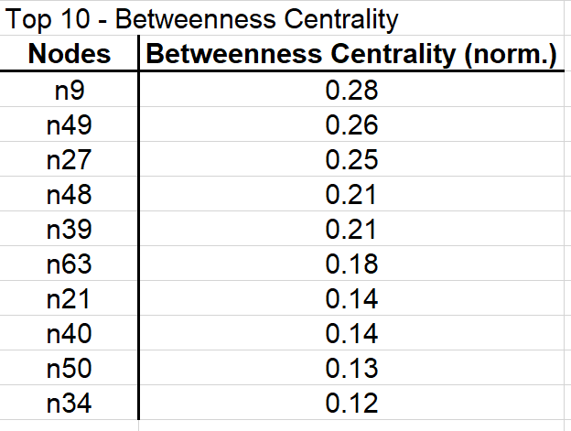
Measure the member’s capacity to act like a bridge between clusters of members!
Indicator 4 – Betweenness Centrality
Mean = 0.016
Max = 0.28
stDev = 0.048

Slide 10
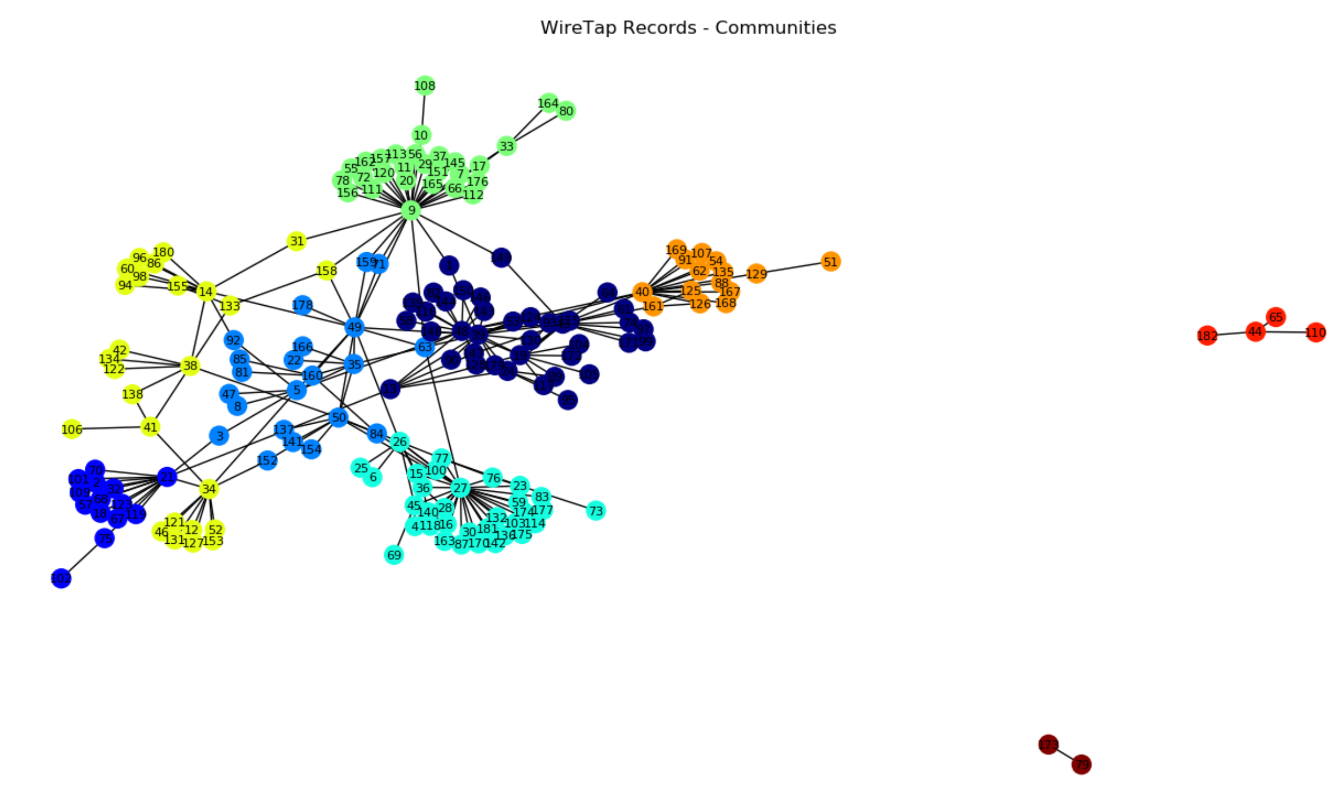
Communities Detection
Algorithm – Louvain algorithm
Communities - 9

Slide 11
What We Got…important nodes!
Top 5:
N9
N27
N49
N48
N39

Slide 12
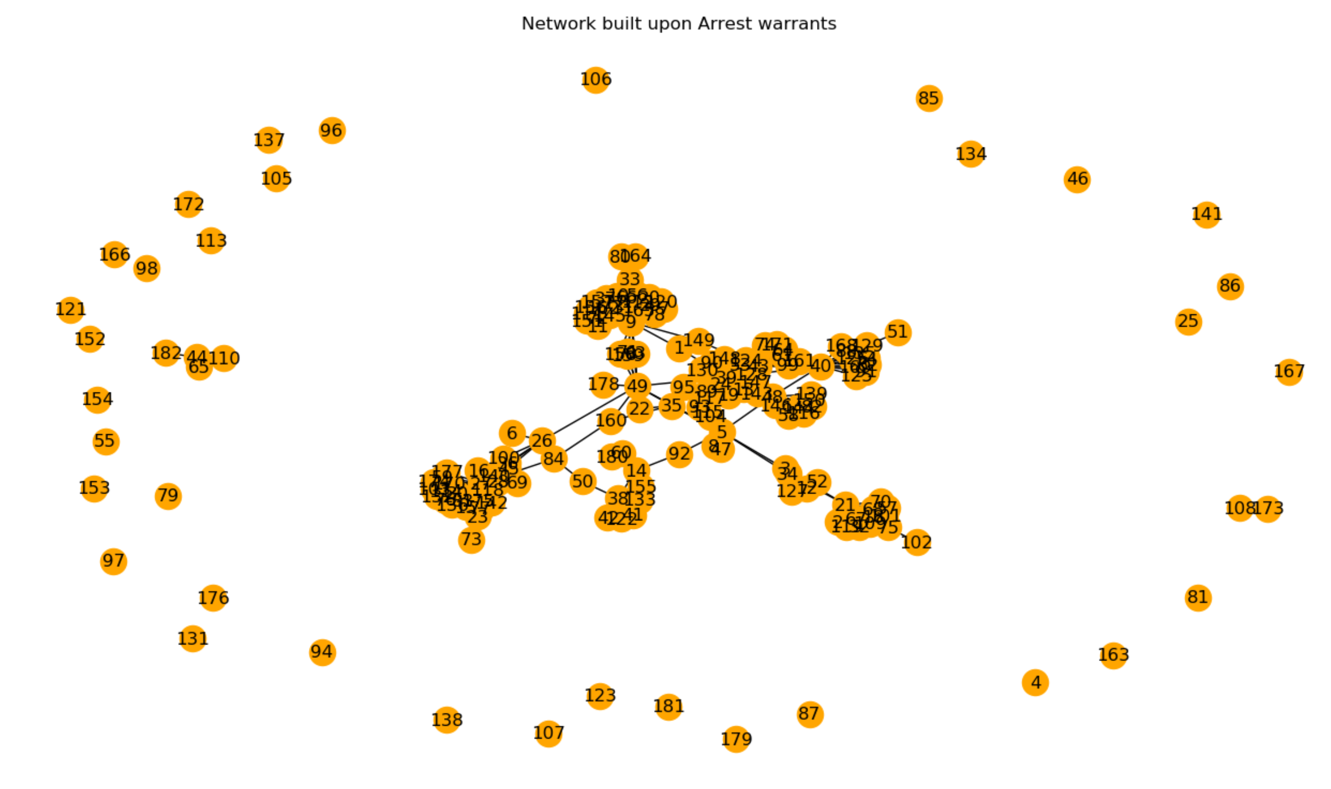
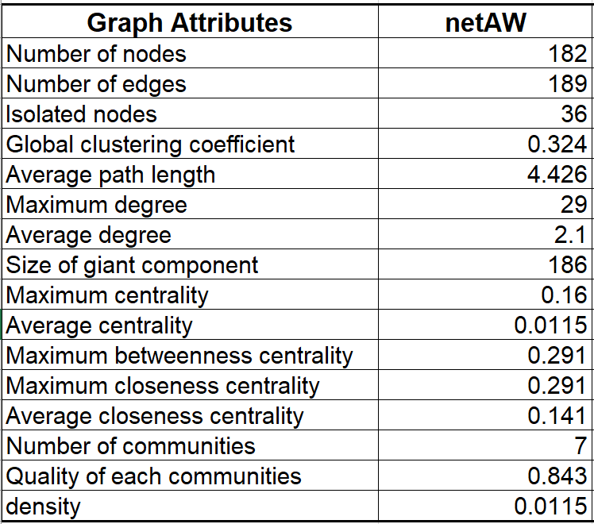
netAW - Original
From netWR:
58 edges were removed to create 36 isolated nodes.

Slide 13
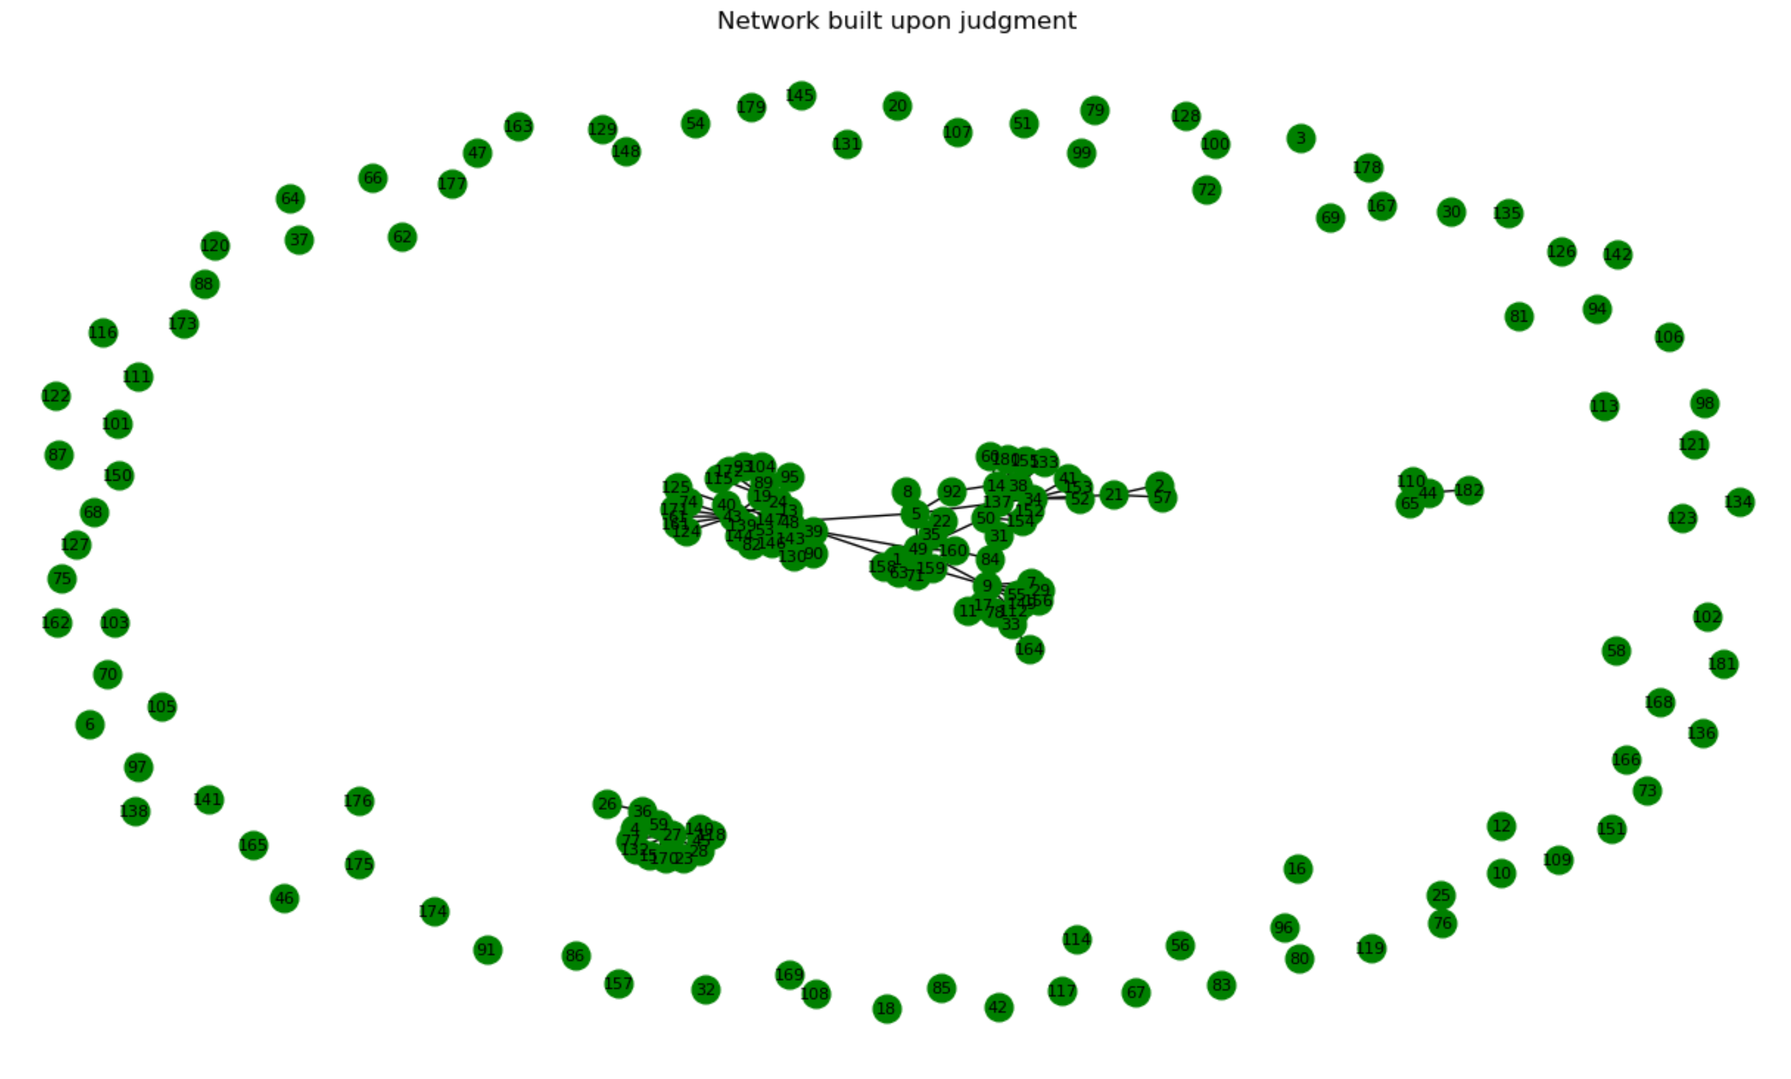
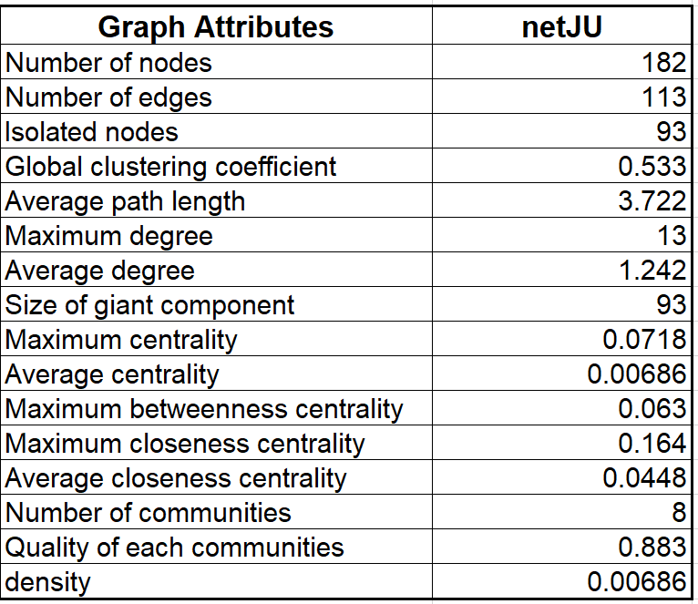
netJU - Original
From netWR:
134 edges were removed to create 93 isolated nodes.

Slide 14
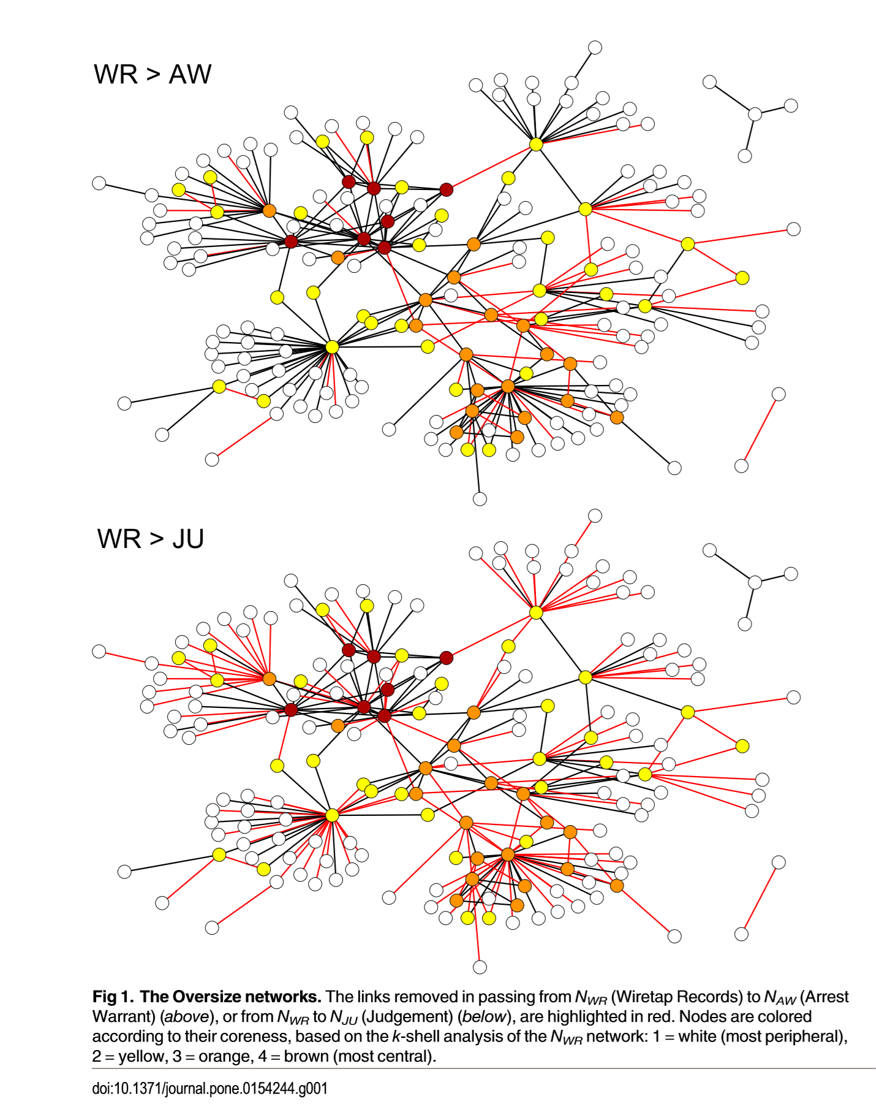

Slide 15
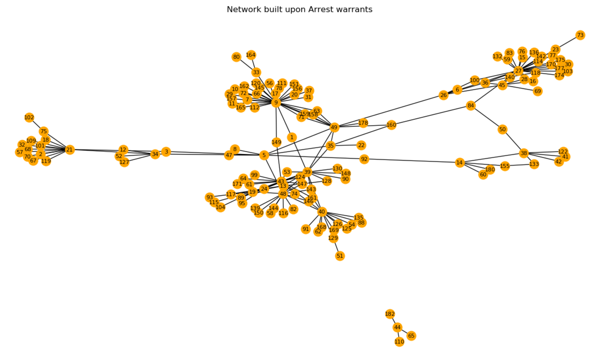
netAW - Isolated nodes removed

Slide 16
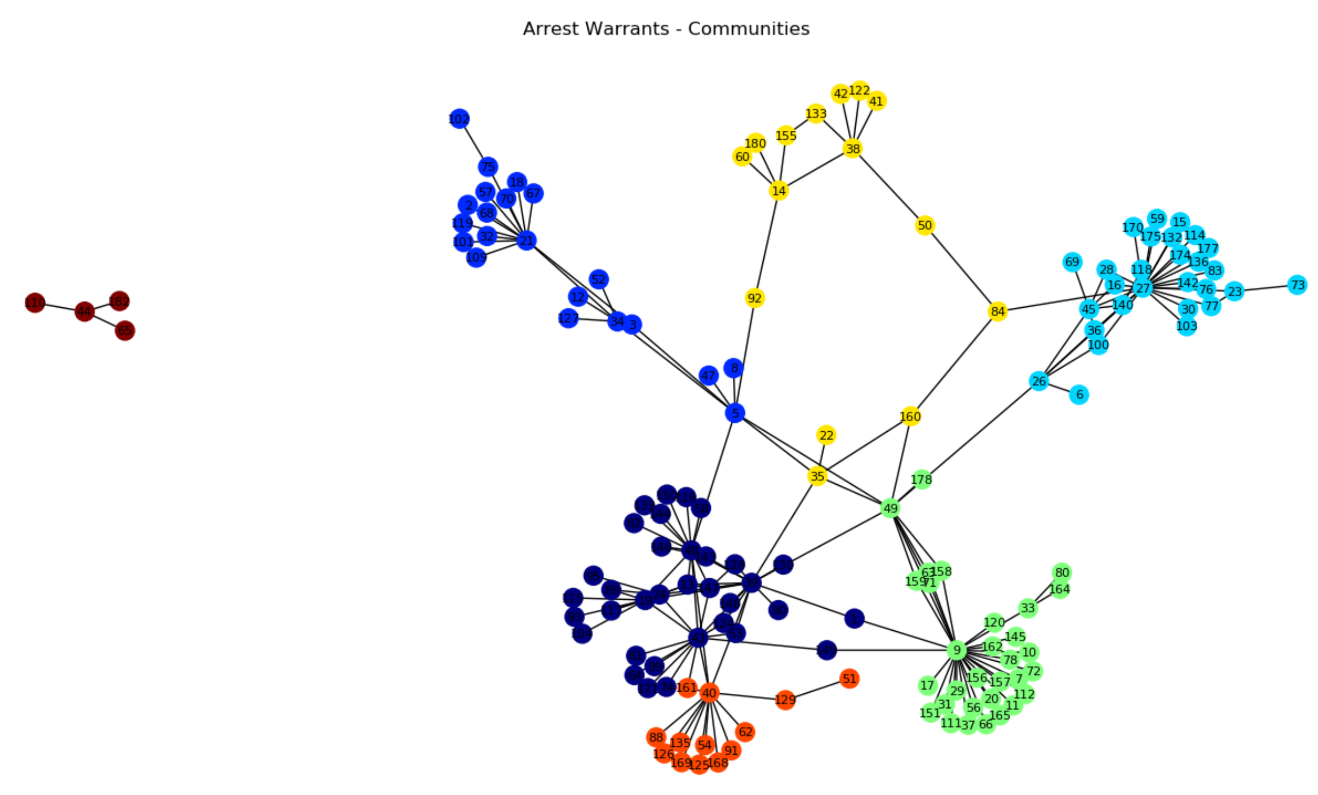
Communities Detection
Algorithm – Louvain algorithm
Communities - 7

Slide 17
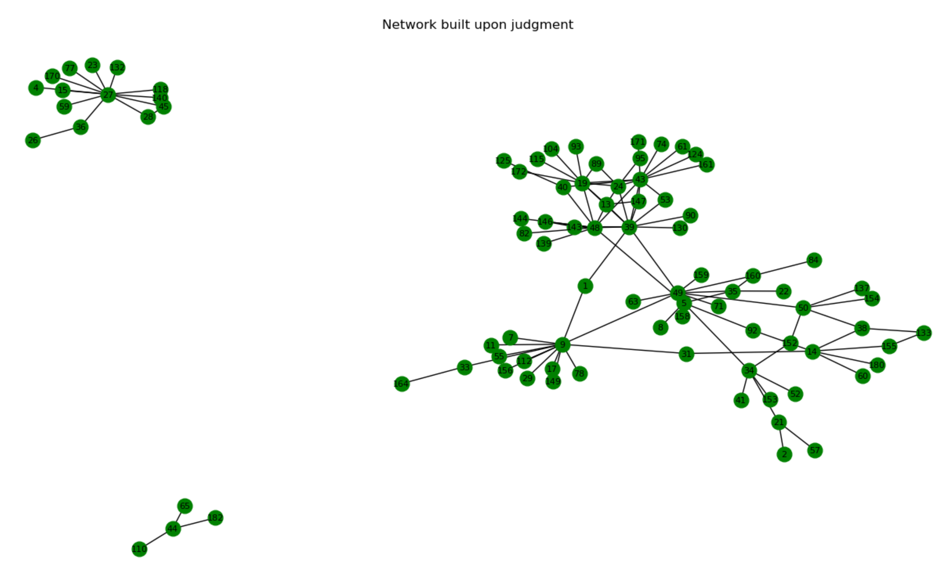
netJU - Isolated nodes removed

Slide 18
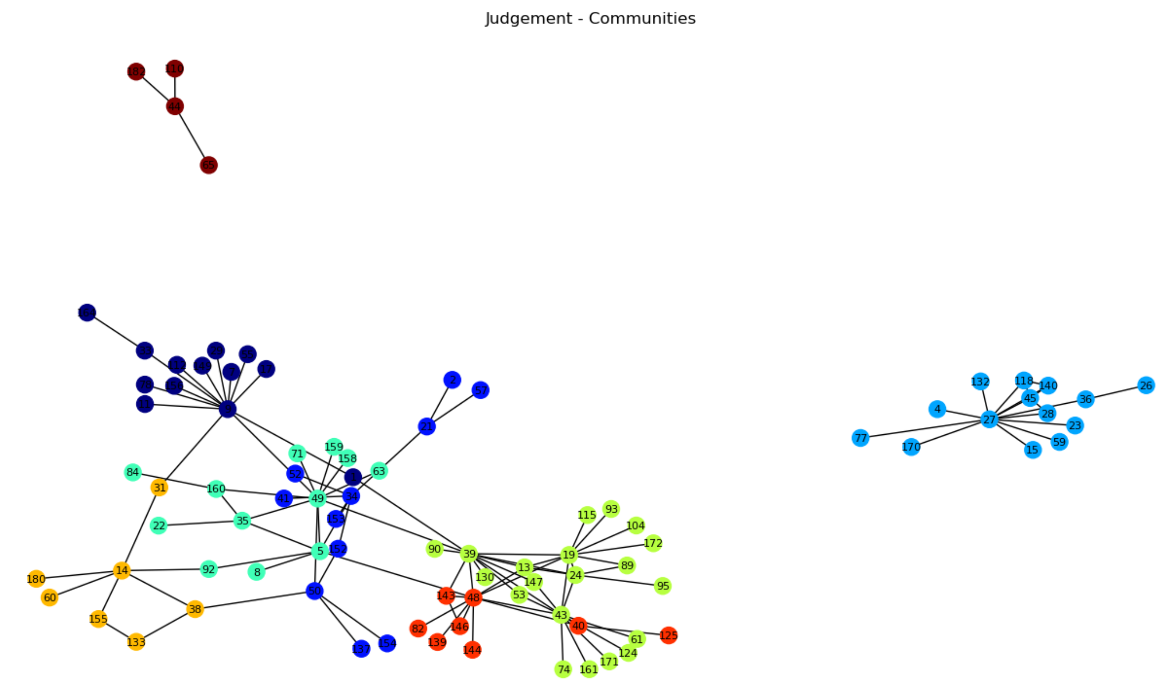
Communities Detection
Algorithm – Louvain algorithm
Communities - 8

Slide 19
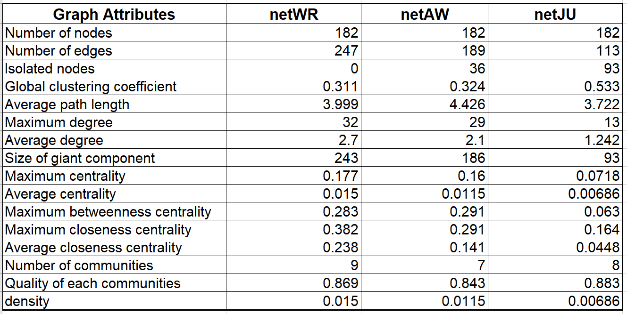
Summary
Graph attributes of three networks

Slide 20
An edge between two nodes is established only if the number of phone calls between the two nodes is beyond a threshold k. (k = 1 ~n)
Create a random number generator that generates a random number between 1 and 40. The generator will give weight to each edge in the graph.
Draw plots showing the evolution with respect to k of:
global clustering coefficient
difference between maximum centrality and average centrality
difference between maximum betweenness centrality and average betweenness centrality
number of communities detected
quality of community detected

Slide 21
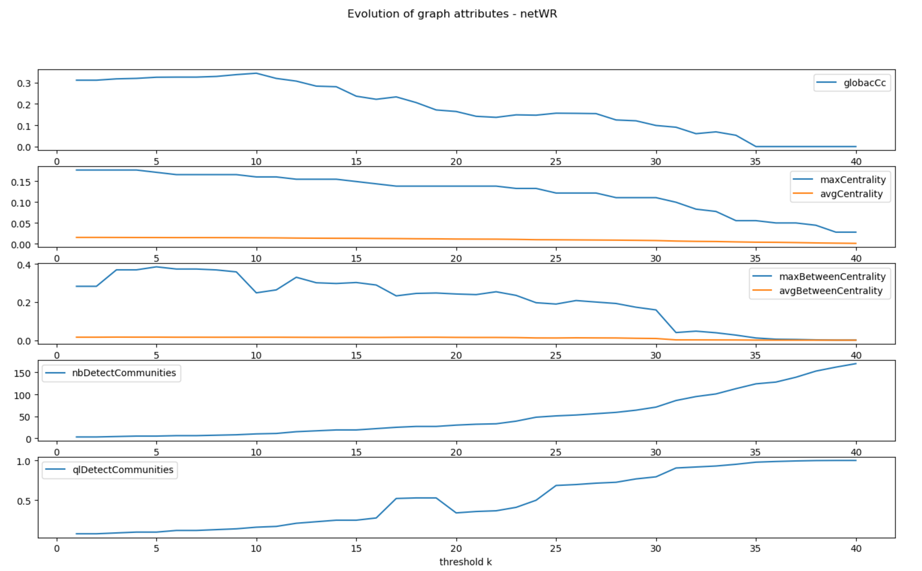
K = 9?

Slide 22
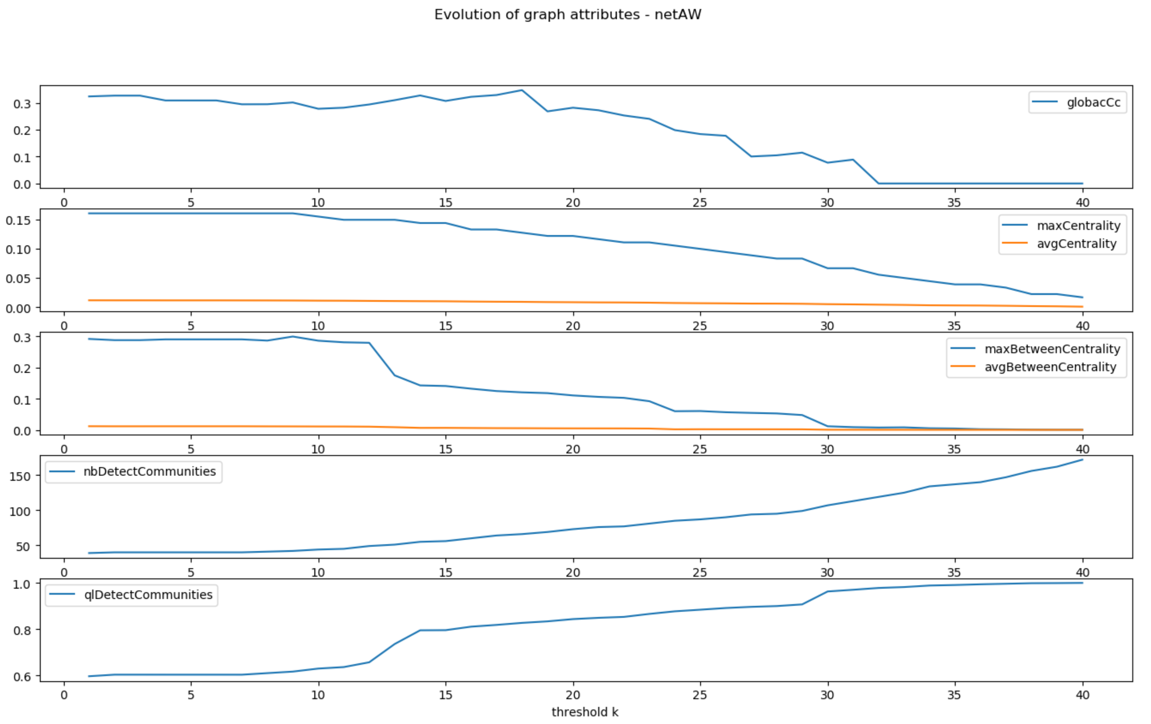
K = 12?

Slide 23
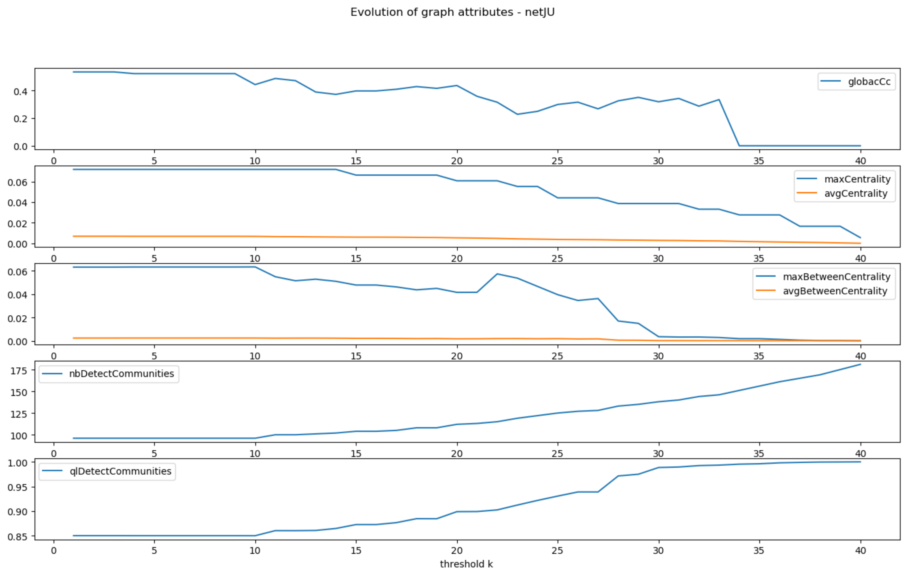
K = 20?

Slide 24
We would like to investigate the consistency between the three networks as a way to construct a new edge allocation mechanism.
we assume that there is an edge between nodes A and B if the number of calls between A and B has shown important change between two Networks.

Slide 25
netWR < ------------ >netAW
need add
-new graph
-new graph attributes

Slide 26
netWR < ------------ >netJU
need add
-new graph
-new graph attributes

Slide 27
netAW < ------------ >netJU
need add
-new graph
-new graph attributes

Slide 28
We would like to simulate a random network whose clustering coefficient, diameter, maximum density, average density are as close as possible to that obtained in question 1 for each of the three networks.

Slide 29
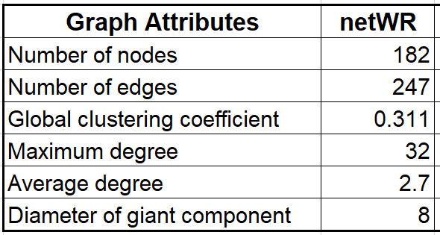
netWR - Original
Target

Slide 30
netWR Simulation
need add
-simulated graph
-simulated graph attributes
-similarity measurement

Slide 31
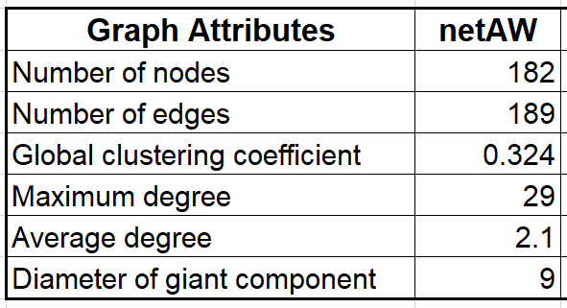
netAW - Original
Target

Slide 32
netAW Simulation
need add
-simulated graph
-simulated graph attributes
-similarity measurement

Slide 33
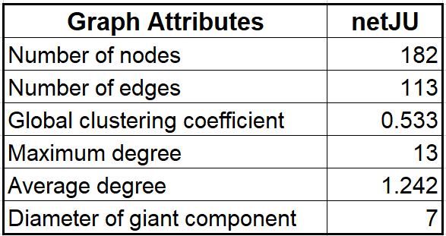
netAW - Original
Target

Slide 34
netJU Simulation
need add
-simulated graph
-simulated graph attributes
-similarity measurement

Slide 35
Deliveries
GUI
Github

Slide 36
References
[1] Berlusconi, G., Calderoni, F., Parolini, N., Verani, M., & Piccardi, C. (2016). Link prediction in criminal networks: A tool for criminal intelligence analysis. PloS one, 11(4), e0154244.
[2] Mastrobuoni, G., & Patacchini, E. (2012). Organized crime networks: An application of network analysis techniques to the American mafia. Review of Network Economics, 11(3).

Slide 37

Thanks for your attention!

